Slide 1
A Guest Lecture on
Optical fiber communication
By
K.S.V.SAMBASIVARAO
HOD
DEPT. OF ELECTRONICS
PBSC COLLEGE Of A & S
VIJAYAWADA

Slide 2
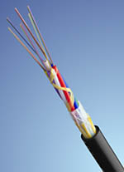
OPTICAL FIBER COMMUNICATION
INTRODUCTION
BASIC COMMUNICATION SYSTEM
BLOCK DAIGRAM
ADVANTAGES
APPLICATIONS
OPTICAL WAVE GUIDES
MODES
SOURCE
DETECTOR
LOSSES IN FIBER

Slide 3
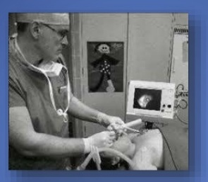
INTRODUCTION
Fiber optic cables are used in telephone system, cable TV (or) internet
They carry digital information over long distance
They transmit light signals over long distance
They can be used in military, submarines, medical imaging e.t.c,
glass or plastic
cladding
plastic jacket
fiber core
Fiber Optical Inner View
Medical

Slide 4
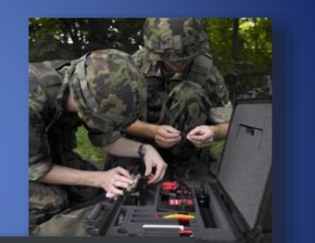
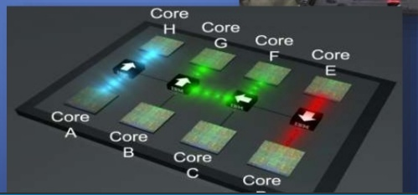
Working Principle of TIR when a ray light travels from a denser to a rare medium such that the angle of incidence is greater than critical angle the ray reflects back in to the same medium this phenomena is TIR
In optical fiber the ray undergo repeated total number of reflections until it emerges out of the other end of fiber ,even if fiber is bent.
military
Electronics

Slide 5
Basic communication system
Transmitter: In this message is generated an put in suitable form
Information channel: It is divided in two categories (i)unguided(ii)guided
Receiver: The message is extracted from the channel and put in final form.
Transmitter
Information channel
receiver

Slide 6
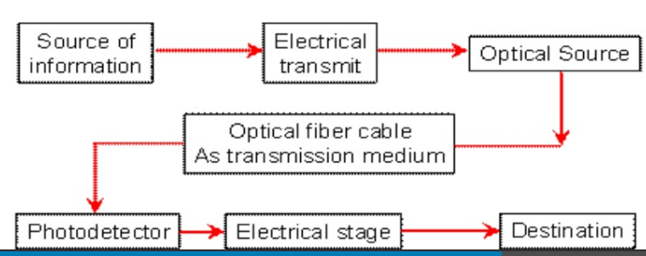
Block diagram
Message Origin: it is a transducer to convert electrical message in to proper format.
Modulator: it perform two functions(i) convert electrical message to proper format(ii)it impress the signal wave generated by source
Carrier Oscillator: carrier wave produced by electronic oscillator for fiber system i.e. LD,LED.

Slide 7
Channel Coupler: In radio/TV it acts like an antenna.
Information Channel: It is a path between transmitter and receiver. It is used to boost up the power level of weak signal.
Detector: In this optic wave convert in to electric current by photodiode.
Signal Processing: In this two types of circuits are used (i)Amplifier (ii)Filter

Slide 8
Advantages
Less expensive
Thinner
High carrying capacity
Less signal degration
Light signal
Non-flammable
Flexible
Medical imaging
Light weight

Slide 9
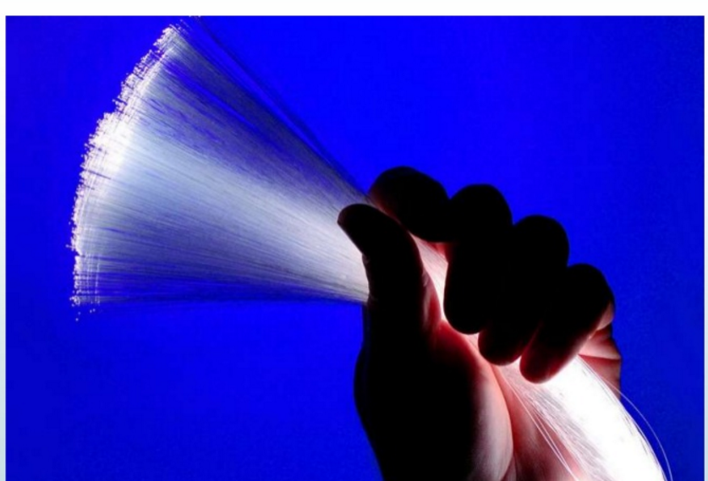
Applications
Telephone applications are wide spread ranging from global n/w to desktop computer
It involves transmission of voice ,data (or) video over distances of less than a meter tom 100km.
POTS(Plain old telephone service) across nation wide network
LECS(Local exchange carries) central office switches at local levels
In cable TV companies also used fiber for delivery of digital video(or) data services.
It used in Bio-medical industry, Modern tele- medicine for transmission of digital diagnostic images.

Slide 10
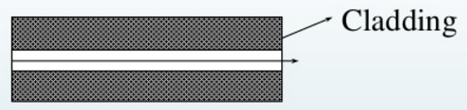
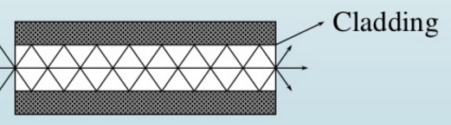
Modes
They are two types of modes
(i) Single mode (ii) Multi mode
Single mode: It has small cores (9 microns in
diameter) and transmit infrared
light and they propagate only in
one direction
Multi mode: It has large cores(62.5 microns in
diameter) and transmit visible &
infrared light rays.
Single-mode
Multi-mode

Slide 11
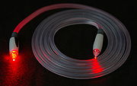
Optical Fiber Wave Guides
Step Index: The rays entering at different angles travel different paths and emerge out at the end of fiber at different times
GRIN : The core has non uniform refractive index in any medium
Materials :
Glass core-Glass cladding
Plastic core-Plastic cladding
The size of fiber denoted by writing a core diameter that cladding diameter both in microns with a slash between them 50/125.
Glass-long distance, Plastic-Short distance

Slide 12
Sources
It is of two types (i)LED (ii) LASER
LED:
It is a P-N junction semiconductor diode that emits light when it is forward bias. voltage drop will be 2 to 4 volts ,area is 1mm,current is 50-100ma,Low energy consumption, long life time, faster switching.

Slide 13
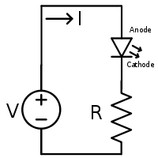
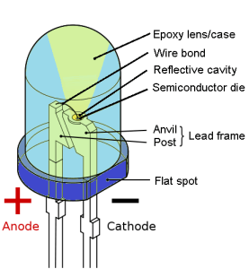
LED

Slide 14
LASER
In this two types (i)He-Ne (ii)Nd:YAG
He-Ne: It is coupled to bare fiber to detect break/cut and by using this NA can be measured.
In this two types of emissions
(i)Spontaneous:-Electrons drops from an excited state to a lower state emitting a photon
(ii)Stimulated:-Photon of same frequency interacts with electron in excited state which drops two lower state.
Duration 10⁻⁸ seconds the atom stay in high state.
11 years in room temperature,&70⁰ -10,000hours.
Notes:
70⁰

Slide 15
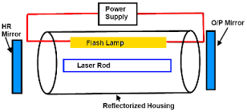
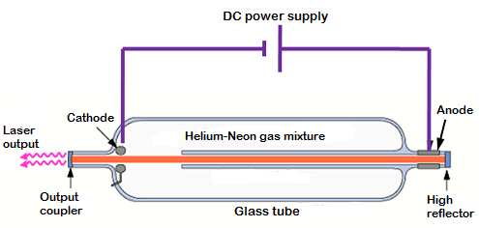
Laser Diode
He_Ne Laser Diode

Slide 16
PHOTO DETECTORS
In this photo detection mechanism are of two types
External:- In which electrons are feed from the surface of a metal by the energy absorbed from an incident stream of photons. EX: Vacuum tube, PMT
Internal:- The free charge carries electrons and holes are generated by absorption of incoming photons. Ex: PN,PIN,APD

Slide 17
Semi conductor:-
They are small, light ,sensitive, fast and operate with a few bias volts
For Emission the diode is forward bias the charges injected in the junction recombination to produce photons
For detection the diode reverse bias to generate electron hole pair producing electric current.
PIN: High resistance ,improve efficiency
APD: It convert light to electricity, High reverse bias, Reverse voltage 100-200v,gain 10⁵-10⁶
Notes:
10⁶

Slide 18
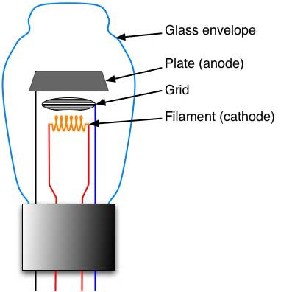
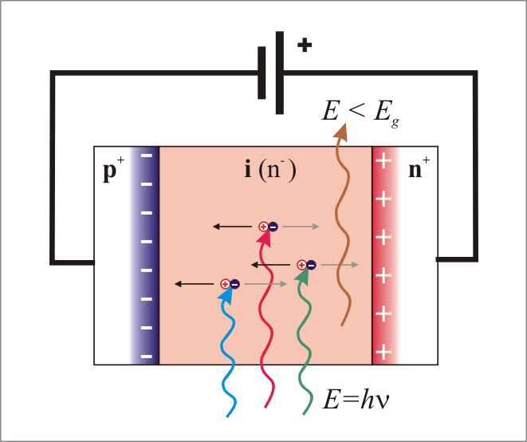
Vacuum tube
PIN photodiode

Slide 19
Losses in Fiber
Attenuation:
Loss of light energy as the light pulse travels from one end of cable to the other.-signal loss(or)fiber loss
It also decide no. of repeaters required between transmitter and receiver.
It directly proportional to length of cable.

Slide 20
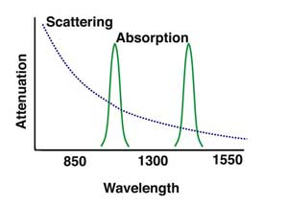
Losses in Fiber Communication

Slide 21
Bending
Macroscopic: in which fiber undergo bends which causes certain modes not be reflected.
Microscopic: Either core (or) cladding undergo slight bends at it’s surface.
Inter modal: Difference between modes with in multimode
Intra modal: Pulse spreading that occurs in single mode
Light energy due to heating of ion impurities results in dimming of light at the end of fiber (i)Intrinsic(ii)Extrinsic
Distortion
Absorption

Slide 22
Measurements
Attenuation-cut back technique, OTDR
Numerical aperture measurement
(i)Scanning photo detector
(ii)Vibration isolated granite slab
Time division multiplexing
Frequency division multiplexing
Measurement losses in splice and connector
Inter-ferometric method
Outer diameter by shadow method

Slide 23
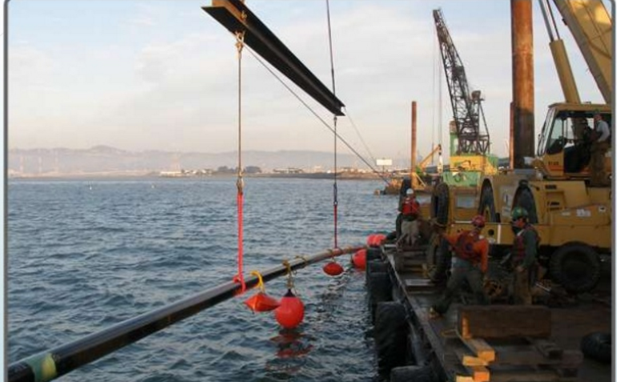
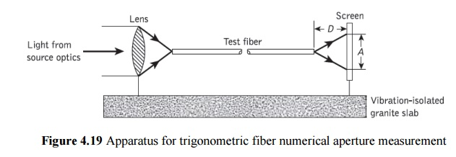
NA=r/√r²+d²

Slide 24
Thank You

